Slide 1
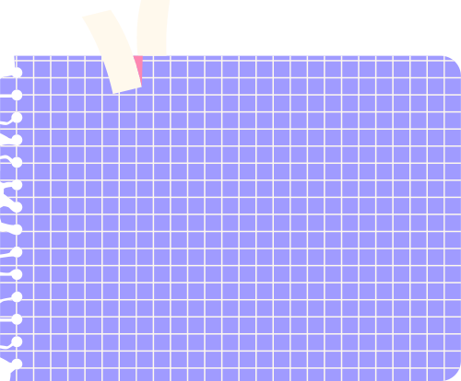




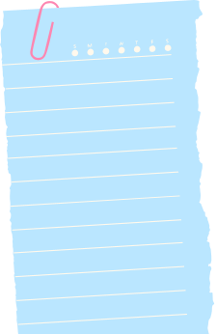
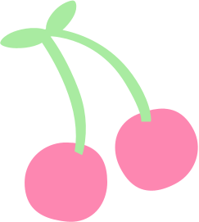



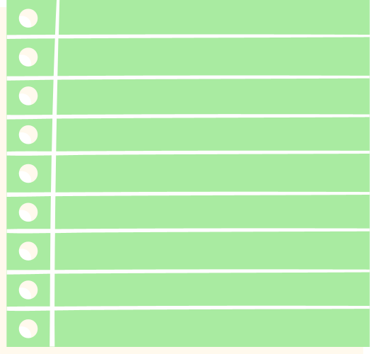
COORDINATES
IN TURTLE

Slide 2





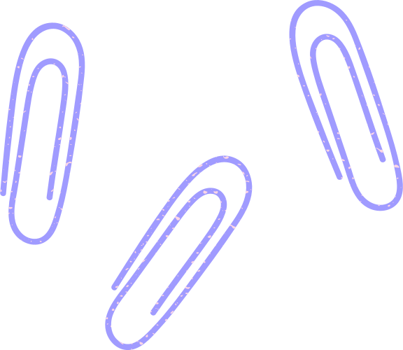
ENABLE Turtle
To work with Turtle, it is necessary to enable scripting mode for Turtle in Python IDLE. To do so, kindly follow the instructions as given in PPT T1-Turtle Graphics.

Slide 3
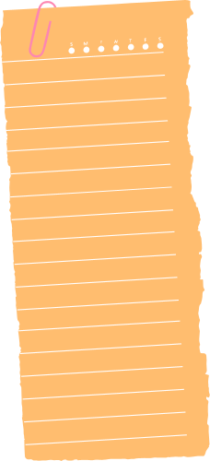
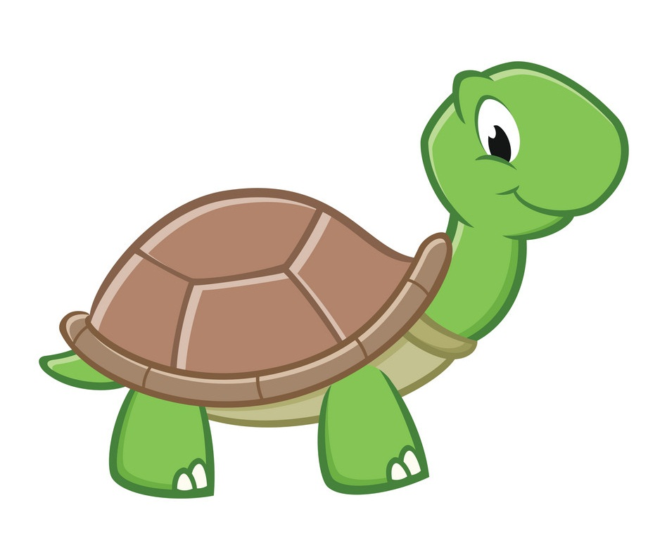
Turtle FEATURES
Turtle provides the following functions to draw, paint and create graphics designs:
Kindly refer to
PPT-T2 on Turtle Features and PPT-T3 on Other Turtle Features before proceeding with
this one.

Slide 4
TELL THE IDLE
YOU WANT TO USE TURTLE
It is mandatory to inform IDLE that you are using Turtle to get all the functionalities given in Turtle. You can type the following command to do so:
from turtle import *

Slide 5
THE NECESSITY TO INFORM
It is mandatory to have the above said statement as the first statement of your Turtle Drawing in order to work with Turtle.

Slide 6
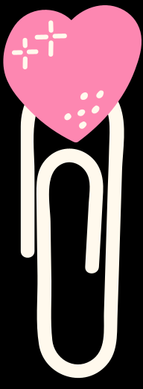
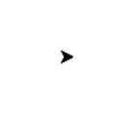
CREATE YOUR
OWN TURTLE
Turtle() function/command creates a new turtle which can be given a name:
my_turtle = Turtle()
This will open the Python Turtle Graphics window with your turtle at the centre.

Slide 7
Name your TURTLE
It is mandatory to name your Turtle according to Variable Naming Rules.
Kindly refer to PPT-6 on Keywords and Identifiers.

Slide 8
QUADRANTS
The Turtle Graphics Window is divided into four squares called Quadrants as shown below:
Each point on the Turtle Graphics Window represents a Coordinate.
Please find attached a
video on Coordinates.
Kindly watch the video
if you have not learnt
about coordinates
before.

Slide 9
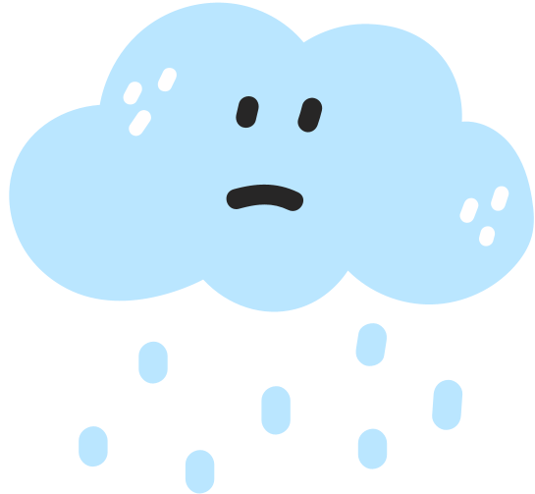
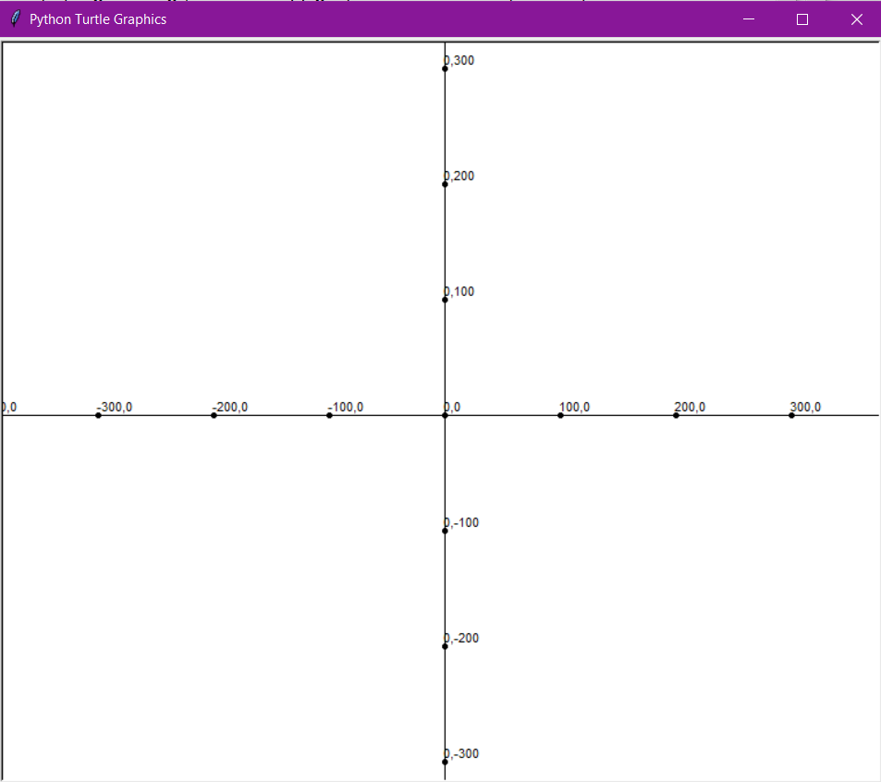

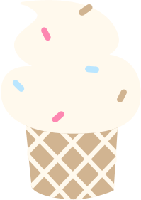




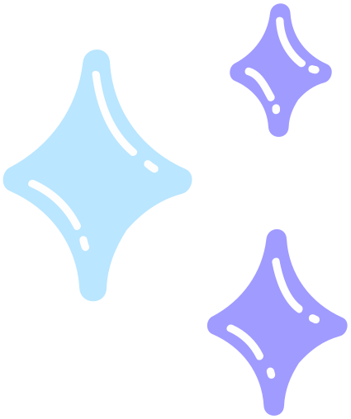



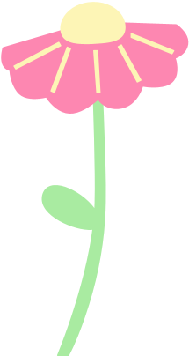

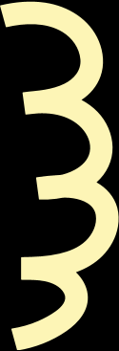
Y-axis
X-axis

Slide 10
COORDINATES
Coordinates are a set of numbers that show you a position on the Turtle Graphics Window.
It can help you find a specific point that you are looking for in the Turtle Graphics Window.
Coordinates are written in parentheses and separated by a comma: (100, 200).
the point on the X-axis is written first, followed by the point on the Y-axis.

Slide 11
COORDINATES
A Coordinate is a combination of a x-value and a y-value.
Along the corridor (X-value first), Up the stairs (Y-value next).
A Coordinate in the Turtle Graphics Window is given as: (x, y)
where x is the distance to be moved right/left and y is the distance to be moved up/down.

Slide 12
IDENTIFICATION OF COORDINATES
To identify the Coordinate of any point, first move right/left along the X-axis (sleeping line/horizontal line) and then move up/down along the Y-axis (standing/ vertical line).
The code for drawing the Quadrants in Turtle Graphics Window is attached below (I have attached this code by the name COORDINATES as Python file also):

Slide 13
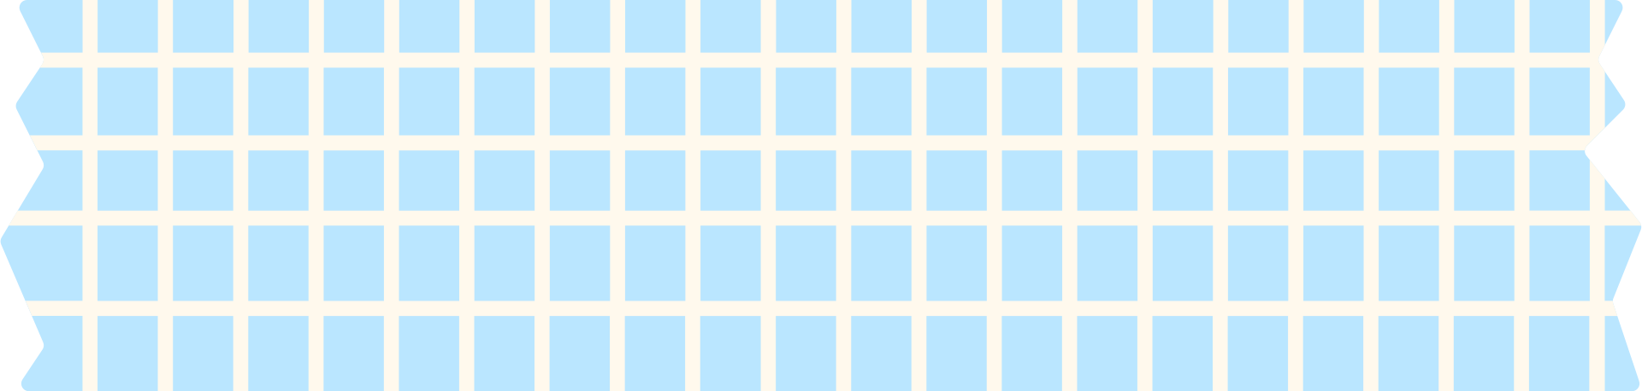
from turtle import *
t = Turtle()
#X-Y Plane
#Positive X
t.dot()
t.write(“(0,0)")
t.forward(100)
t.dot()
t.write(“(100,0)")
t.forward(100)
t.dot()
t.write(“(200,0)")
t.forward(100)
t.dot()
t.write(“(300,0)")
t.forward(100)
t.dot()
t.write(“(400,0)")
QUADRANTS

Slide 14
#Positive Y
t.backward(400)
t.left(90)
t.forward(100)
t.dot()
t.write(“(0,100)")
t.forward(100)
t.dot()
t.write(“(0,200)")
t.forward(100)
t.dot()
t.write(“(0,300)")
t.forward(100)
t.dot()
t.write(“(0,400)")
QUADRANTS

Slide 15
#Negative Y
t.backward(400)
t.right(180)
t.forward(100)
t.dot()
t.write(“(0,-100)")
t.forward(100)
t.dot()
t.write(“(0,-200)")
t.forward(100)
t.dot()
t.write(“(0,-300)")
t.forward(100)
t.dot()
t.write(“(0,-400)")
QUADRANTS

Slide 16
#Negative X
t.backward(400)
t.right(90)
t.forward(100)
t.dot()
t.write(“(-100,0)")
t.forward(100)
t.dot()
t.write(“(-200,0)")
t.forward(100)
t.dot()
t.write(“(-300,0)")
t.forward(100)
t.dot()
t.write(“(-400,0)")
#Main Program
#Start writing your code for Turtle Drawing from here
QUADRANTS

Slide 17
THE NECESSITY TO KNOW ABOUT COORDINATES
Go through the following images to know the importance of coordinates in Turtle Graphics:

Slide 18
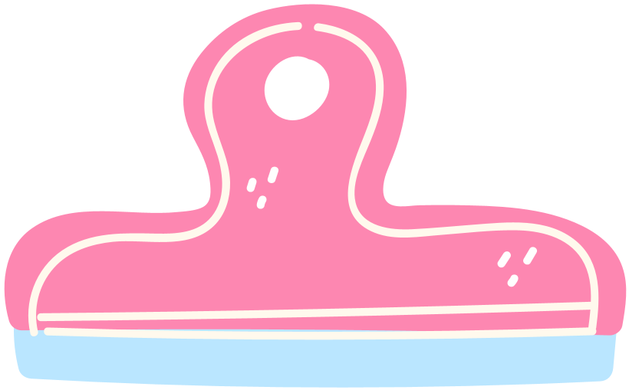
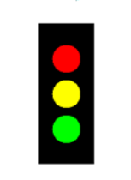
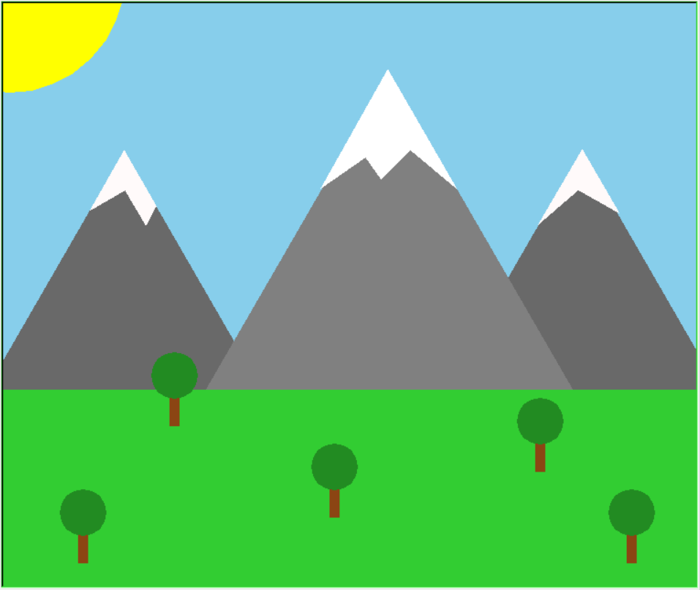
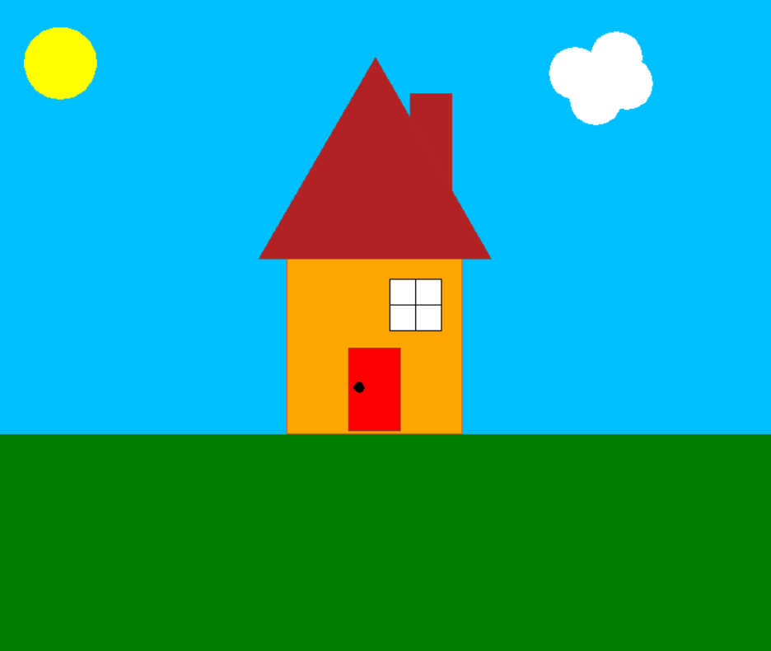
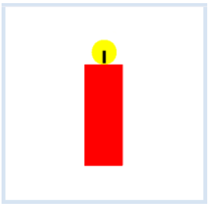
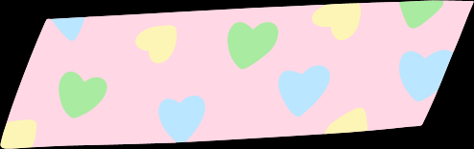
YOU WILL REALISE THAT
YOU CANNOT DRAW THESE IMAGES
WITH THE FUNCTIONS YOU ALREADY KNOW!

Slide 19
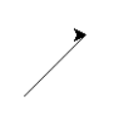
GOTO FUNCTION
goto(x, y) function moves the turtle from its current position to the location (x, y) in the Turtle Graphics Window.
my_turtle.goto(50, 50)
This will move your turtle to the point which has its coordinates as (50,50).

Slide 20
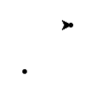
GOTO FUNCTION
goto() function works like forward() function. Whenever we use goto() function, the turtle moves and draws along its path. It is advised to use goto() between penup() and pendown() function where the path not required.
my_turtle.penup()
my_turtle.goto(50, 50)
my_turtle. pendown()
Here, the turtle
moved between the
dots without tracing
its path (drawing
a line).

Slide 21
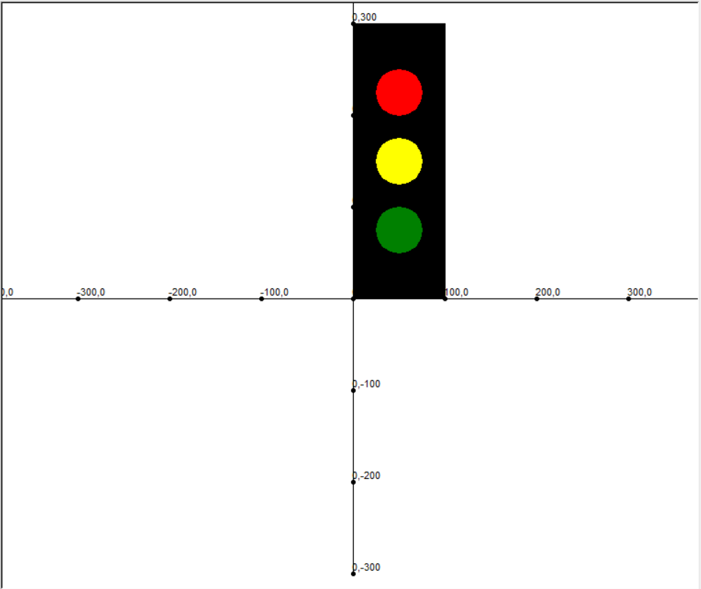
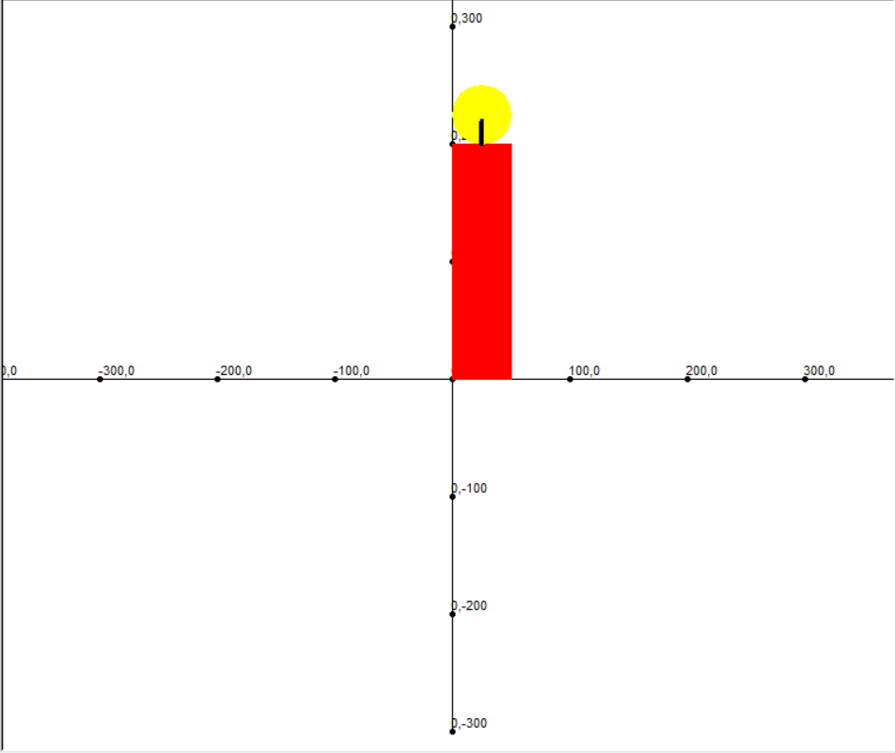
ADVANTAGE OF USING THE COORDINATES CODE TO DRAW IMAGES

Slide 22
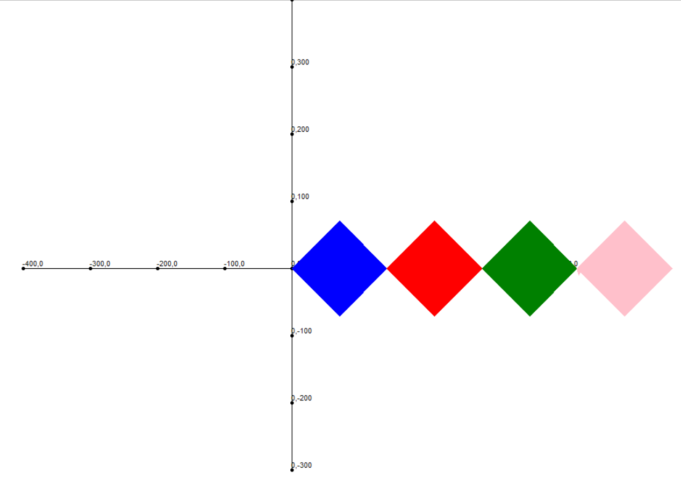
ADVANTAGE OF USING THE COORDINATES CODE TO DRAW IMAGES

Slide 23

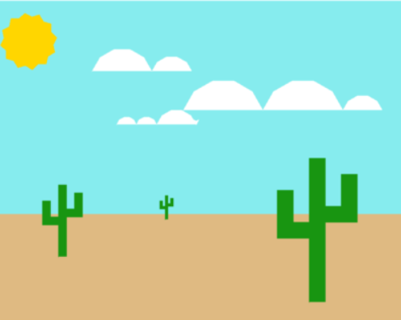
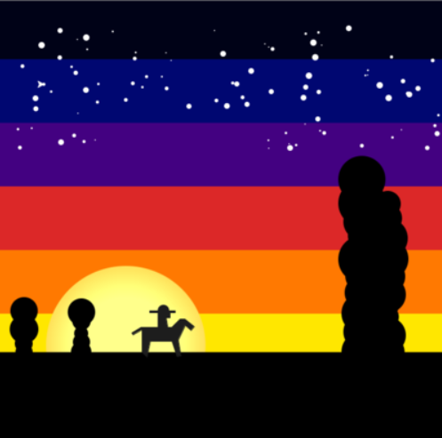
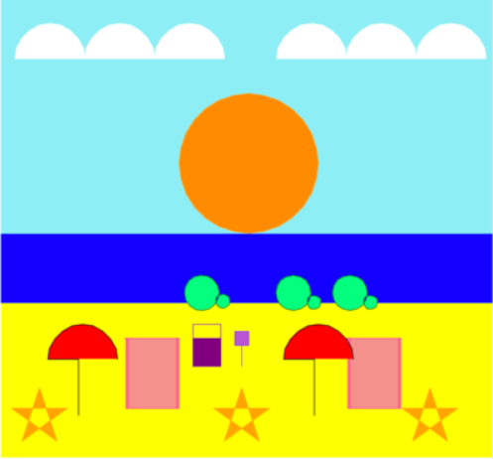
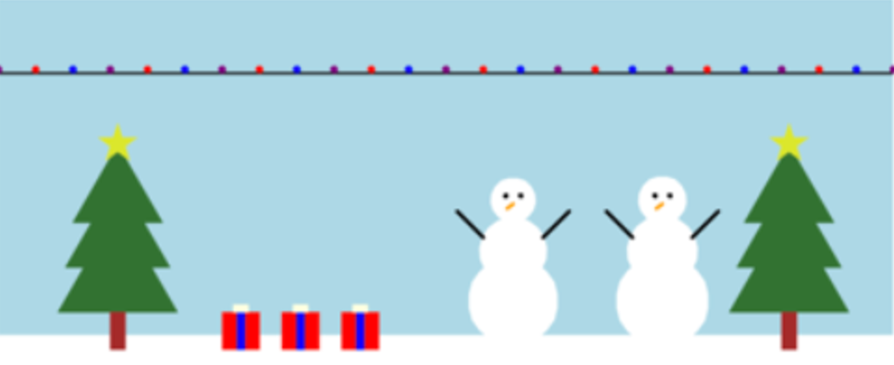
YOU’RE THE ARTIST!!!

Slide 24

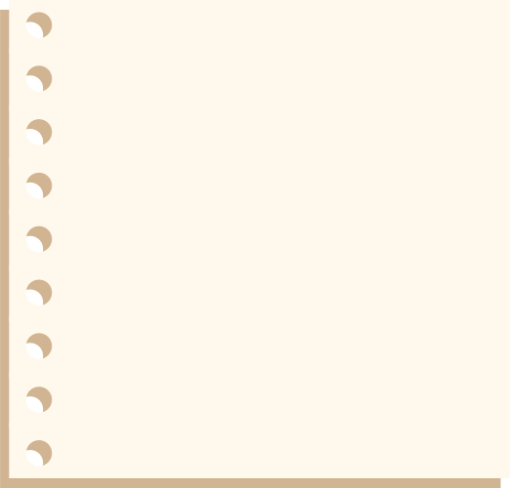
HOW TO USE THE “COORDINATES CODE” TO DRAW MULTIPLE ELEMENTS IN ONE SINGLE
TURTLE WINDOW?

Slide 25
ELEMENTS IN A
TURTLE DRAWING
In this diagram, grass, sky, sun, cloud, roof of the house, window, chimney, door and its handle are individual elements.

Slide 26
ELEMENTS IN A
TURTLE DRAWING
We need to identify the coordinates of those elements in order to combine them and complete our Turtle Drawing.
We can combine the “Coordinates Code” and goto() function to find out the coordinates.

Slide 27
ELEMENTS IN A
TURTLE DRAWING
The code for this Drawing has been attached. Use the same as a reference for your own creation.

Slide 28
USE THESE IMAGES
AS REFERENCE

Slide 29
USE THESE IMAGES
AS REFERENCE

Slide 30

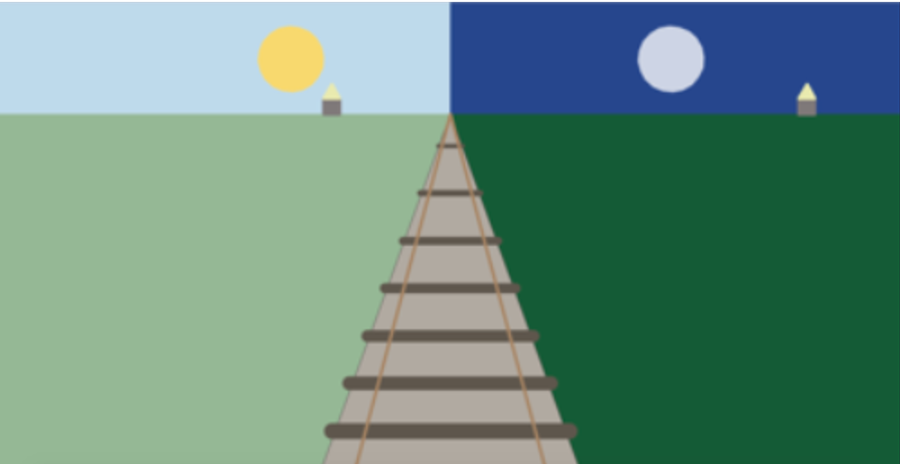

YOUR TURTLE DIAGRAM CAN BE SIMPLE. BUT LET IT BE YOUR ORIGINAL WORK.

Slide 31

HAPPY LEARNING!

